Slide 1
DATABASES
Data storage

Slide 2
DATABASES
🔹 Databases allow us to store data permanently and that it can be retrieved as needed. 👉 No database, After rebooting, all data is deleted and returned to its initial state 👉Because the data is stored in temporary memory (RAM).
There are two main types of databases: ✔ SQL databases – relational (structured) ✔ NoSQL databases are non-relational (no strict structure)

Slide 3
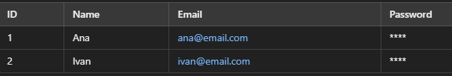
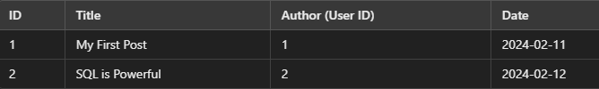
DATABASES - SQL
👉 SQL (Structured Query Language) is a language that allows queries over a structured database. 👉These databases have been around for decades and are also called relational databases. 👉The data is organized into tables (similar to Excel spreadsheets). 👉Each table contains columns (columns) that define data types. 👉 Each row of the table is a new record. 👉 Relationships between data allow tables to be connected. 👉 Every blog post has a foreign key. 👉 We can easily retrieve all posts of a particular user using SQL queries.
✔ PostgreSQL 🏆 (the most popular among developers!) ✔ MySQL ✔ SQLite ✔ Microsoft SQL Server ✔ Oracle Database (but costs $$$)

Slide 4
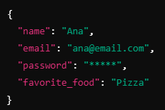
DATABASES - NOSQL
👉 The data is stored as JSON objects instead of tables. 👉There is no fixed structure, which means that we can dynamically add fields. 👉We can add a new field to any user without changing the entire database. 👉Flexibility – each user can have different attributes.
✔ MongoDB (the most popular NoSQL) ✔ Redis ✔ DynamoDB (Amazon Database)
Notes:
https://github.com/rwaldron/idiomatic.js – kako pisati dobar javascript kod.
📌 Kratka Povijest Web Preglednika
🔹 Netscape Navigator – Dominirao web preglednicima 90-ih godina. 🔹 Internet Explorer – Glavni konkurent, izazvao „rat preglednika“. 🔹 Mosaic – Prethodnik Netscapea, jedan od prvih preglednika. 🔹 Firefox – Nastao iz ostataka Netscapea, donio inovacije.
Marc Andreessen, jedan od ključnih ljudi iza Netscapea, imao je viziju dinamičnog weba, a kako bi to omogućio, bilo je potrebno razviti novi skriptni jezik koji bi radio u pregledniku.
📌 Nastanak JavaScripta
🔹 1995. godine – Web stranice su bile statične, a sav posao obrade podataka odvijao se na serveru. 🔹 Netscapeov tim – Želio je dinamičan web s animacijama i interakcijom u pregledniku. 🔹 Brendan Eich – Unajmljen da razvije skriptni jezik, kreirao JavaScript za samo 10 dana! 🔹 Prvotni naziv – JavaScript se u početku zvao LiveScript, ali zbog popularnosti Jave, ime je promijenjeno.
📌 Što Se Događa Ako Isključimo JavaScript?
🔹 Twitter bez JavaScripta – Ne može prikazati brojač znakova kod tvitanja. 🔹 YouTube i Netflix – Ne rade uopće bez JavaScripta. 🔹 New York Times bez JavaScripta – Sajt se učitava bez oglasa jer su oni često temeljeni na JavaScriptu.
Ovo pokazuje koliko smo danas ovisni o JavaScriptu – bez njega, internet ne bi bio isti!

Slide 5
DATABASES – OVERVIEW
This is a controversial topic among developers. 🔥 💡 SQL databases are structured, reliable, and efficient for large projects. 💡 NoSQL databases are more flexible and easier for beginners, but they can cause problems with large systems. 🏆 PostgreSQL is the most popular database among professionals! ➡ MongoDB is popular among beginners, but many professional developers prefer SQL.
🎯 Why are we going to learn PostgreSQL? 📌 PostgreSQL is the best choice because: ✔ Free and open-source ✔ Fast and scalable ✔ Reliable for large projects ✔ Most popular among professionals
Notes:
https://github.com/rwaldron/idiomatic.js – kako pisati dobar javascript kod.
📌 Kratka Povijest Web Preglednika
🔹 Netscape Navigator – Dominirao web preglednicima 90-ih godina. 🔹 Internet Explorer – Glavni konkurent, izazvao „rat preglednika“. 🔹 Mosaic – Prethodnik Netscapea, jedan od prvih preglednika. 🔹 Firefox – Nastao iz ostataka Netscapea, donio inovacije.
Marc Andreessen, jedan od ključnih ljudi iza Netscapea, imao je viziju dinamičnog weba, a kako bi to omogućio, bilo je potrebno razviti novi skriptni jezik koji bi radio u pregledniku.
📌 Nastanak JavaScripta
🔹 1995. godine – Web stranice su bile statične, a sav posao obrade podataka odvijao se na serveru. 🔹 Netscapeov tim – Želio je dinamičan web s animacijama i interakcijom u pregledniku. 🔹 Brendan Eich – Unajmljen da razvije skriptni jezik, kreirao JavaScript za samo 10 dana! 🔹 Prvotni naziv – JavaScript se u početku zvao LiveScript, ali zbog popularnosti Jave, ime je promijenjeno.
📌 Što Se Događa Ako Isključimo JavaScript?
🔹 Twitter bez JavaScripta – Ne može prikazati brojač znakova kod tvitanja. 🔹 YouTube i Netflix – Ne rade uopće bez JavaScripta. 🔹 New York Times bez JavaScripta – Sajt se učitava bez oglasa jer su oni često temeljeni na JavaScriptu.
Ovo pokazuje koliko smo danas ovisni o JavaScriptu – bez njega, internet ne bi bio isti!

Slide 6
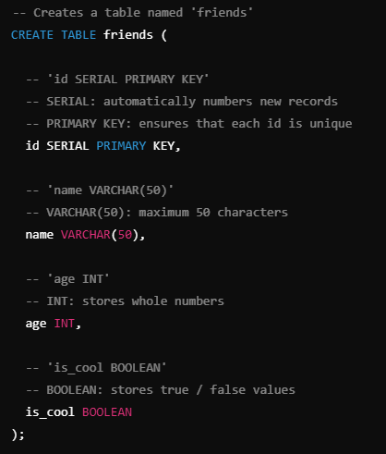
DATABASES – POSGRESQL DATA TYPES
PostgreSQL offers a wider range of data types compared to standard SQL. 🔹 Textual data: VARCHAR(n) – Variable text length (maximum n characters) TEXT – Unlimited text length 🔹 Numbers: INT – Integers BIGINT – Large integers (for billions of records) DECIMAL(10,2) – Decimal numbers (e.g. prices) 🔹 Date and time: DATE – Stores only the date TIMESTAMP – Stores the date and time 🔹 Other: BOOLEAN – true / false values SERIAL – Auto-incrementing number for primary keys 📌 What format to use for text? VARCHAR(50) = limit to 50 characters TEXT = no restriction
💡 U modernim aplikacijama često se koristi TEXT jer nema problema s ograničenjem duljine. Postoji mali gubitak brzine, ali je fleksibilnije za rastuće baze podataka.
Notes:
Instaliranje u local 1. Windows Users: Download the Postgres Installer here:
https://sbp.enterprisedb.com/getfile.jsp?fileid=1258649
1. Mac Users: Download the Postgres Installer here:
https://sbp.enterprisedb.com/getfile.jsp?fileid=1258653
https://www.postgresql.org/docs/current/datatype.html

Slide 7
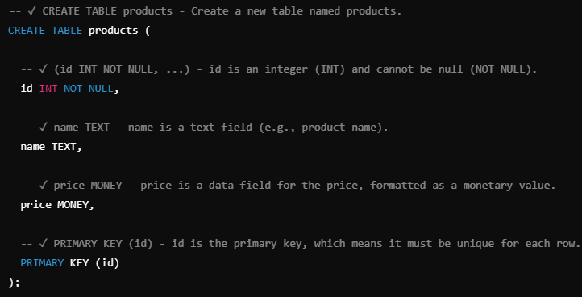
DATABASES – CREATE TABLE
SQL is a query language that we can: 👉 Add data 👉 Retrieve data 👉 Update data 👉 Clear data
Notes:
w3schools.com/sql
sqliteonline.com

Slide 8
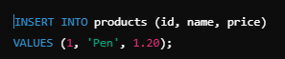
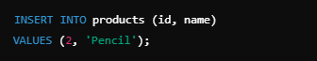
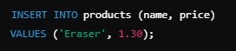
DATABASES – INSERT
👉 Example of adding the first product
👉 Adding another product (but no price)
👉 Example that causes the error:
Notes:
w3schools.com/sql
sqliteonline.com

Slide 9

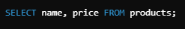
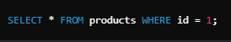
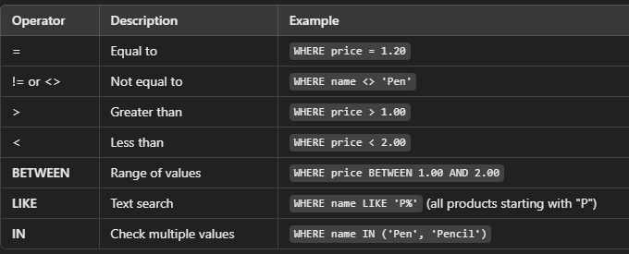
DATABASES – SELECT
👉 Retrieve all data 👉 If we do not want all the columns, we can only indicate the ones that interest us 👉 How to filter data?
Notes:
w3schools.com/sql
sqliteonline.com

Slide 10
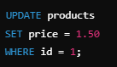
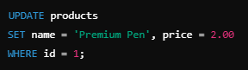
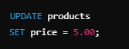
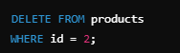
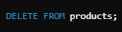
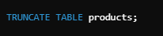
DATABASES – UPDATE & DELETE
👉 Updating data in the SQL database
Caution!!
👉 Update multiple columns at once
Caution!!
👉 Delete data
👉 How to delete ALL data but keep the table?

Slide 11
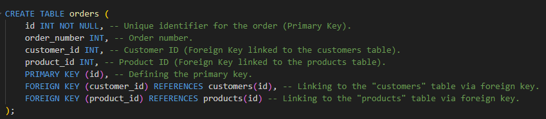
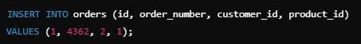
DATABASES – SQL RELATIONS & JOIN
👉 Primary Key (PK) – Identifies each record within the table (unique ID).
👉 Add your first order

Slide 12
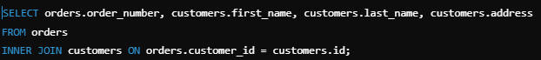
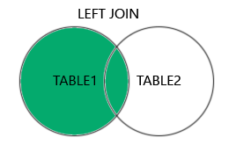
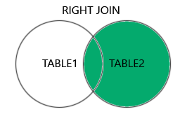
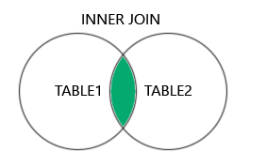
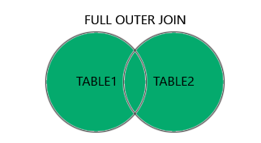
DATABASES – SQL RELATIONS & JOIN
👉 One of the most powerful functionalities of SQL is JOIN, which allows us to join tables based on the relationships between them.
There are different types of JOINS in SQL: 👉 INNER JOIN – Joins only those rows that have a match in both tables. 👉 LEFT JOIN – Includes all rows from the left table and only matching ones from the right. 👉 RIGHT JOIN – The opposite of LEFT JOIN. 👉 FULL JOIN – Returns all rows from both tables, regardless of match.

Slide 13
DATABASES – EXERCISE 1
Get the order number, product name, price, and stock status. Retrieve the customer's name, the product they purchased, the price, and the order number from multiple tables at the same time.

Slide 14
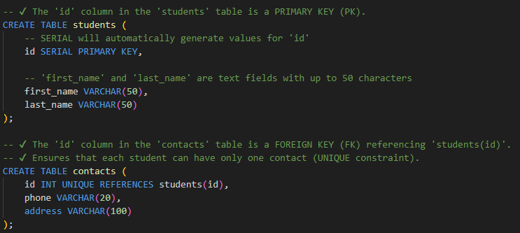
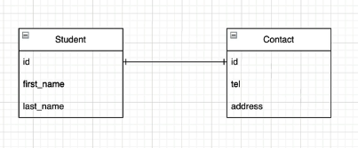
DATABASES – RELATIONAL DATABASES
👉 Relationships allow you to connect data from multiple tables, which increases the efficiency of searching and organizing data.
This relationship means that one row in one table corresponds exactly to one row in another table. It is used to modularize the base and avoid oversized tables with too many columns.

Slide 15
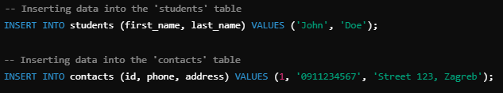
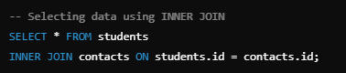
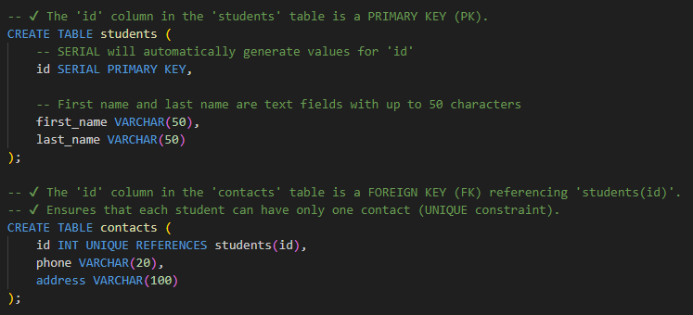
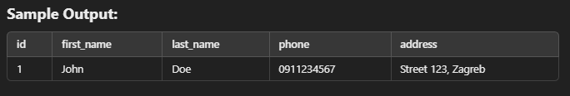
DATABASES – ONE ON ONE (1:1)
👉 Ovaj odnos znači da jedan redak u jednoj tablici odgovara točno jednom retku u drugoj tablici. Koristi se za modularizaciju baze i izbjegavanje prevelikih tablica s previše stupaca.

Slide 16
DATABASES – EXERCISE 2
🚀 Try creating these tables in PostgreSQL on your own and testing the JOIN query! ✔ You can add more students and their contacts. ✔ You can experiment with adding new attributes to your tables.

Slide 17
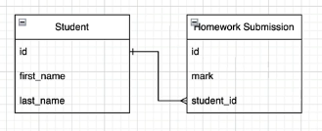
DATABASES – ONE TO MANY(1:M)
👉 A one-to-many (1:M) relationship occurs when one record in one table can be related to multiple records in another table.
💡 Real-life examples: ✔ One student can submit multiple homework. ✔ One customer can make multiple orders. ✔ One author can write multiple books.

Slide 18
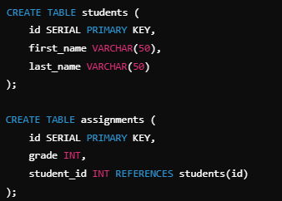
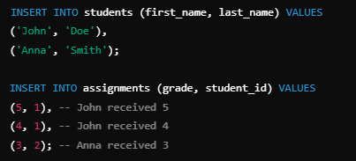
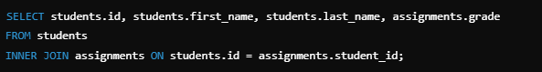
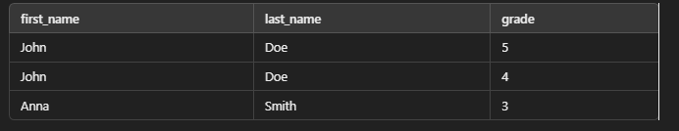
DATABASES – ONE TO MANY(1:M)
Creating Tables
Inserting data
Retrieving data from INNER JOIN

Slide 19
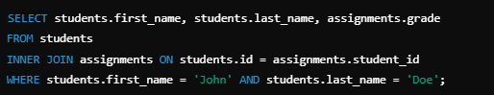
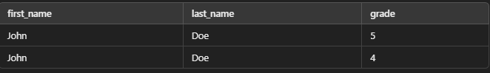
DATABASES – ONE TO MANY(1:M)
Select only specific data

Slide 20
DATABASES – EXERCISE 3
🚀 Try to create these tables in PostgreSQL on your own and test JOIN queries! ✔ You can add more students and more assignments. ✔ You can experiment with adding new attributes to tables (e.g., assignment date).

Slide 21
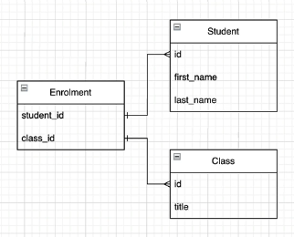
DATABASES – MANY TO MANY(M:M)
👉 In a Many-to-Many relationship, one record in one table can be related to multiple records in another table, and vice versa.
💡 Real-life examples: ✔ A student can be enrolled in multiple courses, and each course has multiple students. ✔ Customers can purchase multiple products, and each product can be purchased from multiple customers. ✔ Authors can write multiple books, and each book can have multiple authors.

Slide 22
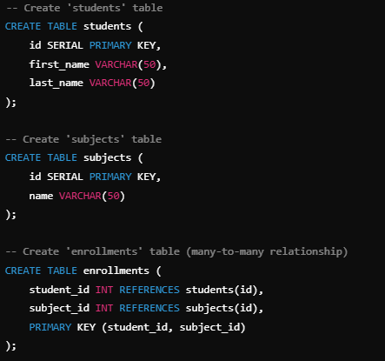
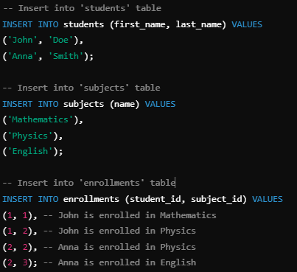
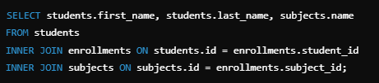
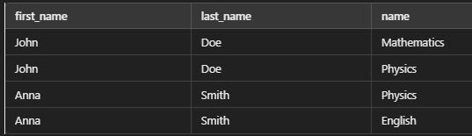
DATABASES – MANY TO MANY(M:M)
👉 In a Many-to-Many relationship, one record in one table can be related to multiple records in another table, and vice versa.
Creating Tables
Inserting data
Retrieving data from JOIN

Slide 23
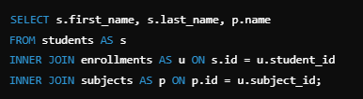
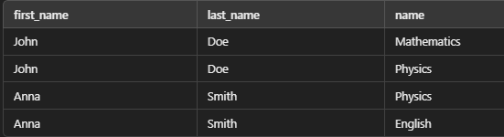
DATABASES – MANY TO MANY(M:M)
Truncate a query by using an alias (AS)
✔ Students → S ✔ Enrollment → in ✔ Items → P
💡 The same result, but a shorter and clearer query!

Slide 24
DATABASES – EXERCISE 4
🚀 Try to create these tables in PostgreSQL on your own and test JOIN queries! ✔ You can add more students and subjects. ✔ You can experiment with adding new attributes (e.g., grades in the Enrollment table).

Slide 25
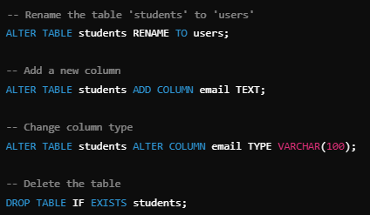
DATABASES – ALTER TABLE

Slide 26
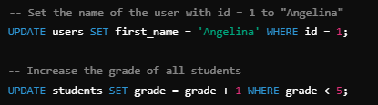
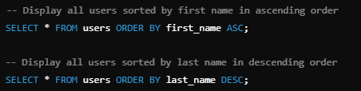
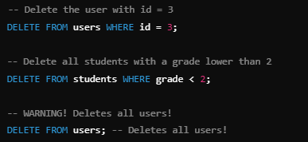
DATABASES – UPDATE,DELETE, ORDER BY
Update
Order by
Delete

Slide 27
DATABASES – EXERCISE 5
🚀 Try it yourself: ✔ Update the first_name of the user with ID 2. ✔ Delete user with ID 5. ✔ Sort users by last name in ascending order.

